Slide 1
Ruixiang Liu, Wuhan University (WHU)
Overview and Sprint Goals for TrainingDML-AI
March 2025 Open Standards Code Sprint
13 March 2025

Slide 2
1. Overview

Slide 3
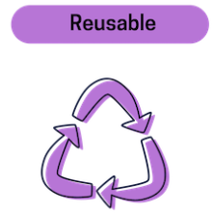
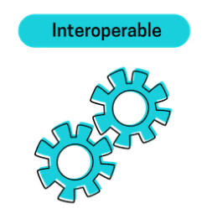

Background
The EO training data for deep learning could come from different organizations with different resolutions and ground truth but without adequate metadata, which makes it burdensome for the users to access and use.
The lack of training data is causing reproducibility issues and making it difficult to compare results across studies.
The existing training datasets are usually packaged into a public or personal repository, lacking discoverability and accessibility.
³
March 2025 Open Standards Code Sprint

Slide 4
Background
Scope of the TrainingDML-AI
Documents the UML model (and encodings) with a target of maximizing the interoperability and usability of EO imagery training data;
Defines different AI/ML tasks and labels in earth observation in terms of supervised learning, including scene level, object level and pixel level tasks;
Describes the description of the permanent identifier, version, license, training data size, measurement or imagery used for annotation, and so on;
Defines the description of quality (e.g., training data errors, training data unrepresentativeness) and the provenance (labeling, labeler, and labeling procedure).
⁴
March 2025 Open Standards Code Sprint

Slide 5
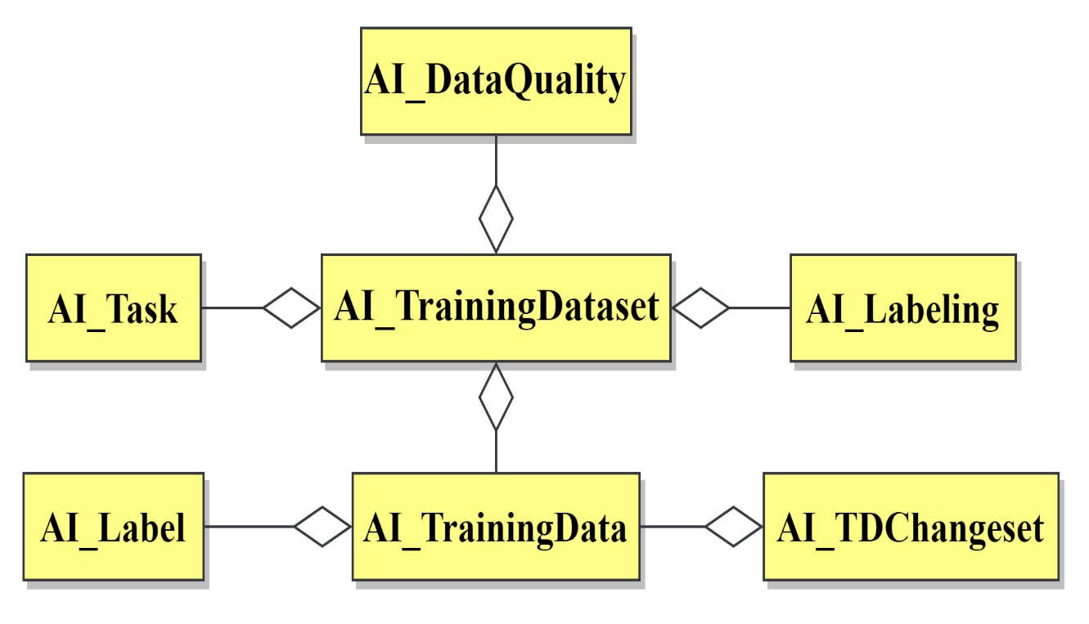
TrainingDML-AI
The TrainingDML-AI Core Concepts
The core concepts in the UML model follow 9 key considerations: identification of core elements for AI/ML training data, granularity, label semantics, provenance, quality, light-weight protocol, extensibility for specific AI/ML applications, TD changes, and alignment with existing standards.
AI_TrainingDataset
AI_TrainingData
AI_Label
AI_Task
AI_DataQuality
AI_Labeling
AI_Labeler
AI_LabelingProcedure
AI_TDChangeset
⁵
March 2025 Open Standards Code Sprint

Slide 6
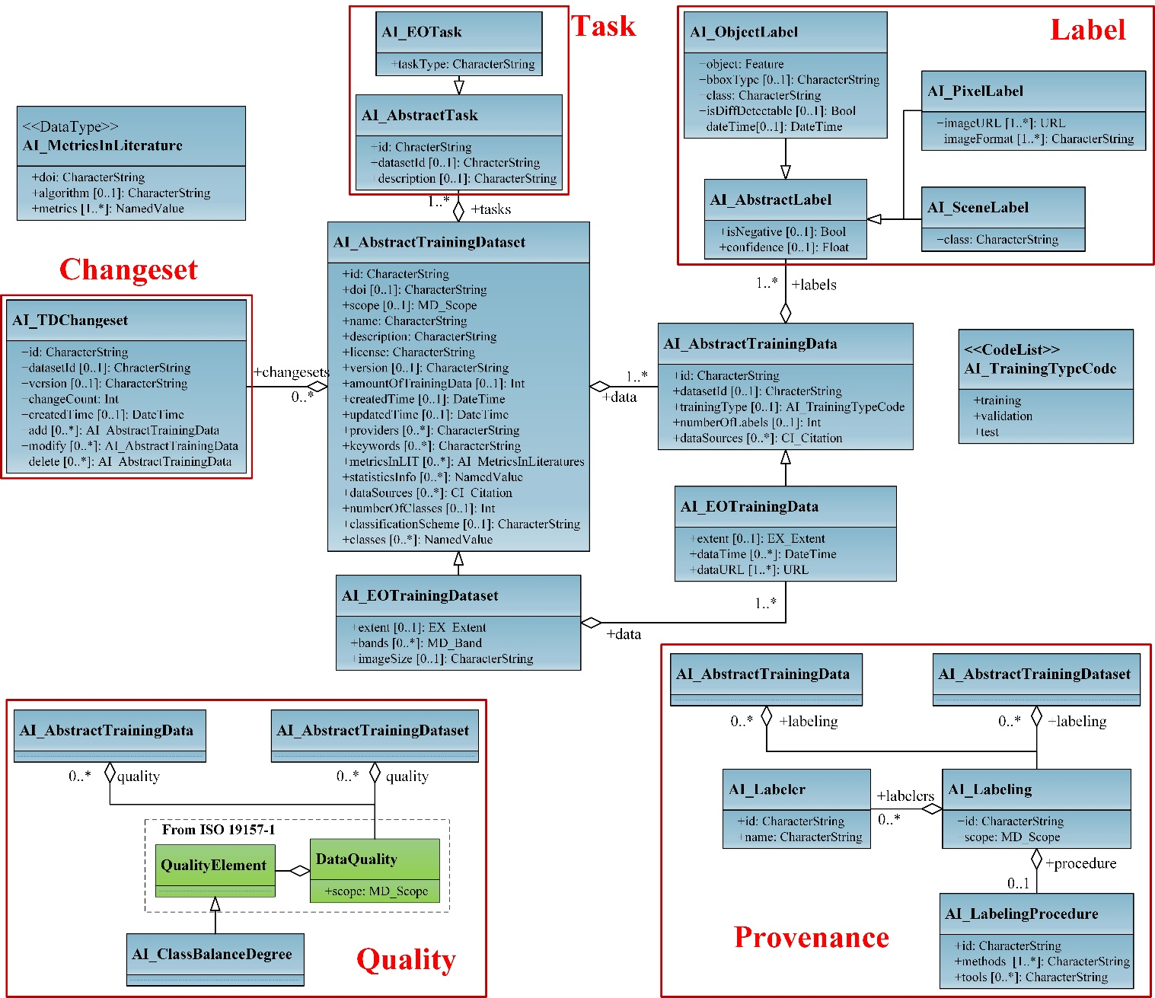
TrainingDML-AI
The TrainingDML-AI UML Model
Different from the high level concepts for training data modeling, the concrete UML model will focus on implementations with basic attributes defined for off-the-shelf deployment. Concepts related to the AI/ML EO applications are defined as classes extended from abstract classes.
⁶
March 2025 Open Standards Code Sprint

Slide 7
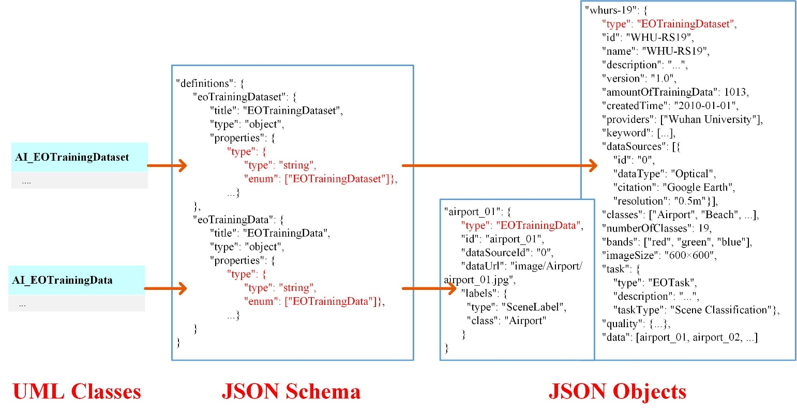
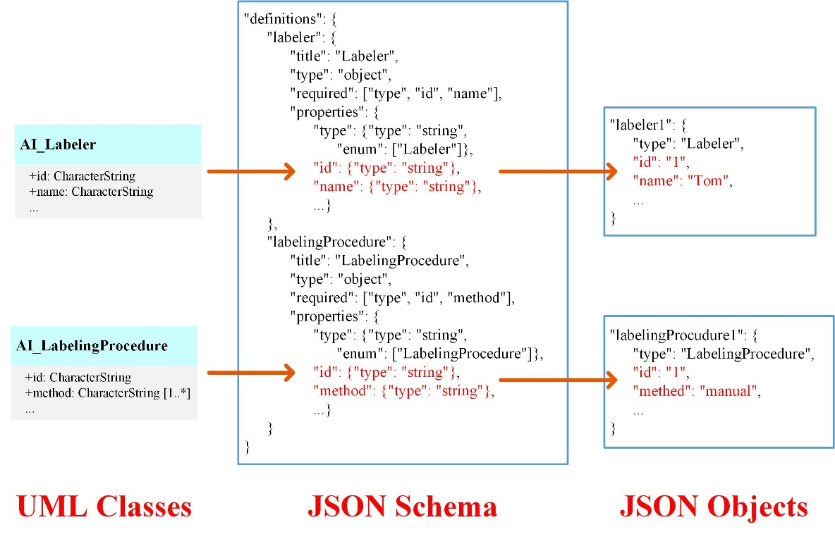
TrainingDML-AI
Language Encoding
The following provides a set of rules that the TrainingDML-AI JSON follows. It shows how the JSON schema can be formulated to define the structure of JSON encoding for TrainingDML-AI.
(1) Class encoding
(2) Attribute encoding
⁷
March 2025 Open Standards Code Sprint

Slide 8
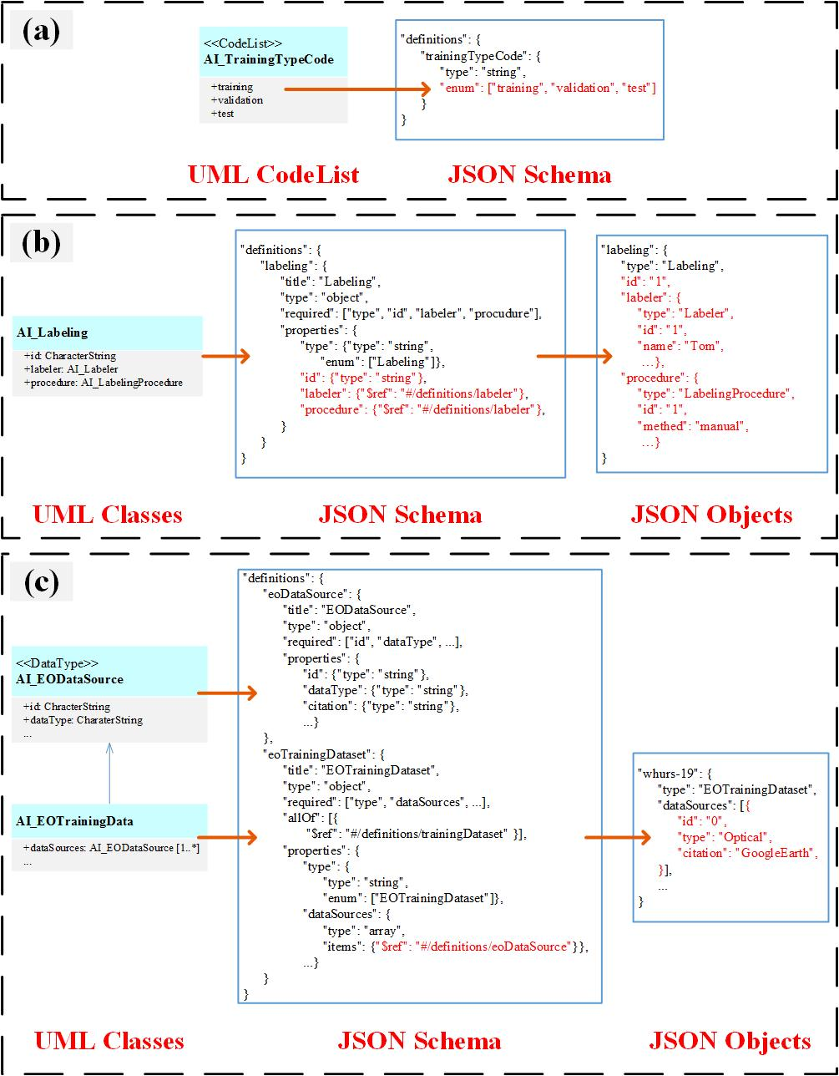
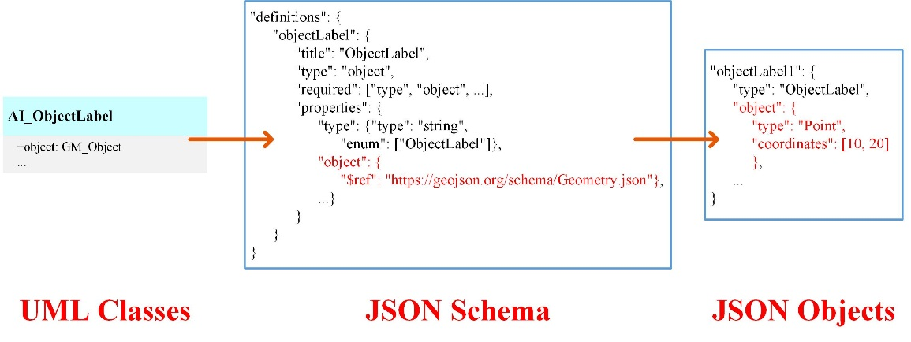
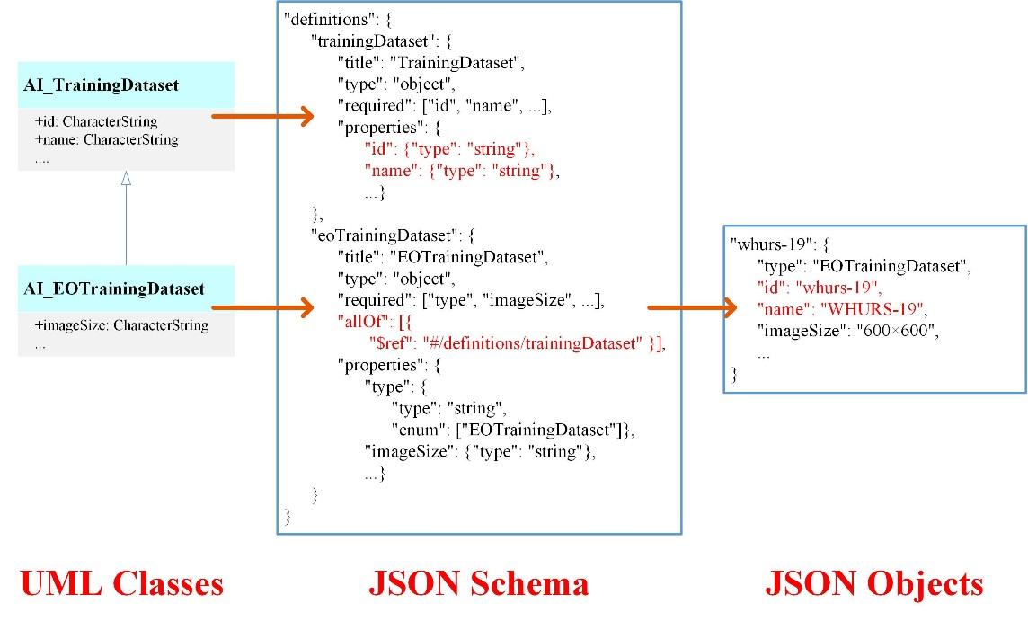
TrainingDML-AI
Codelist
Language Encoding
Object value
(4) Geometric object encoding
Data type class
(3) Complex value encoding
(5) Inheritance encoding
⁸
March 2025 Open Standards Code Sprint

Slide 9
2. Sprint goals

Slide 10
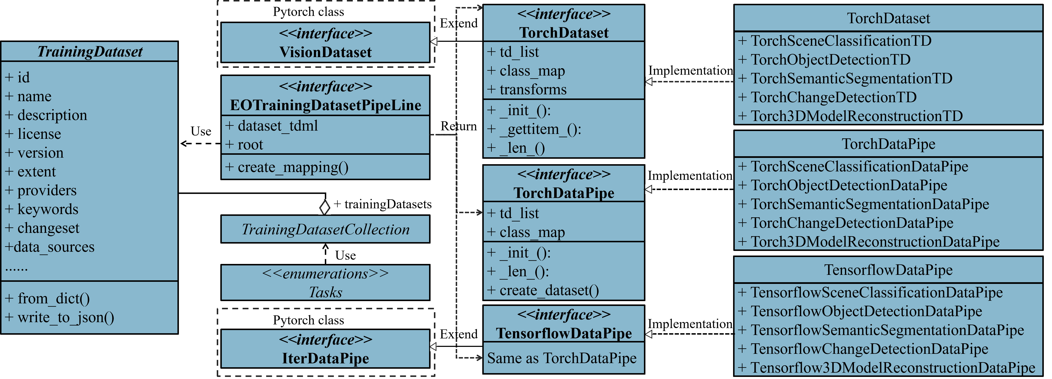
PyTDML
PyTDML is a pure Python parser and encoder for training datasets based on the OGC TrainingDML-AI Standard. PyTDML is a library used for processing and managing training datasets.
The structure of classes implemented by PyTDML
¹⁰
March 2025 Open Standards Code Sprint

Slide 11
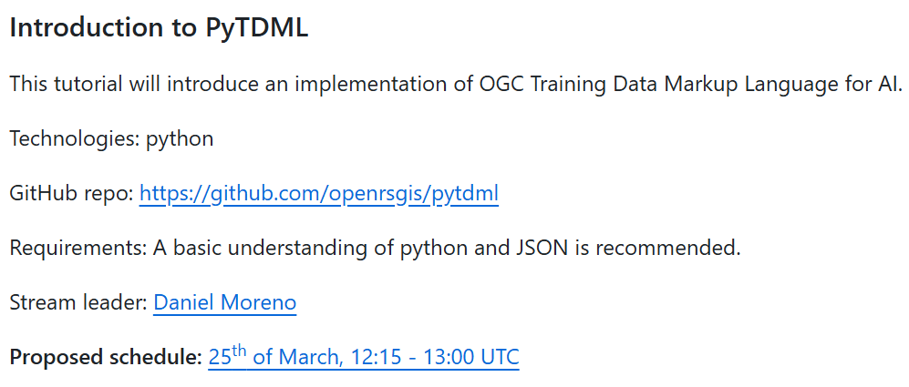
Goals
¹¹
March 2025 Open Standards Code Sprint

Slide 12
Work Plan
Preparation Phase
GitHub Issue Planning
Technical Design
Core Sprint Phase
Code Quality & Standardization
Core Feature Enhancement
PyPi Release Preparation
OGC Code Sprint 2025 Participation Plan
Hosting Role: Host a Node during the March 2025 OGC Code Sprint, fully dedicated to PyTDML development and event coordination.
Collaborative Planning: Pre-define sprint tasks via GitHub Issues to allow community contributors to claim modular tasks.
Focus Areas: Leverage conference resources to drive code quality enhancement and core feature iteration.
¹²
March 2025 Open Standards Code Sprint

Slide 13

Thank You!
hello@ogc.org
2300, Wilson Blvd. Suite 700-1026, Arlington, VA 22201, USA
www.ogc.org

